Slide 1
Negotiating a Commercial Real Estate Lease
By Randy Mason, Commercial Realty Specialists

Slide 2
The Players to a Commercial Real Estate Lease
Landlord
Third party affiliations to the landlord include:
Listing Brokers
Real Estate Agents
Attorney
Architects
Tenant
Third Party affiliations to the tenant include:
Tenant Representatives/Brokers
Attorney
Project Coordinators
Designers
Cablers
Movers

Slide 3
Negotiate to Win
Negotiating a lease usually starts with the landlord’s lease terms
As a tenant, DO NOT settle for the landlord’s terms. Negotiate for what you need!
Hiring a trusted tenant representative who negotiates on your behalf is highly recommended

Slide 4
Negotiate the Rent
Rent is measured by the annual or monthly cost per square foot of the space
Ex: Landlord’s offer: $24 per sq. foot
Tenant’s offer: $18 per sq. foot
Do your homework! Research:
What neighboring tenants are paying
Landlord’s history

Slide 5
Negotiate the Length of a Lease
Commercial leases typically run anywhere from 1-10 years
Long term leases may be what you need
Location
Make payments more affordable
Ideal solution is to negotiate for a short initial lease term with one or more options to renew, if no improvements are necessary
EX: a one- or two-year lease with an option to renew for two or three more years
If improvements are needed, the landlord may require a longer term lease to amortize the cost over a longer term

Slide 6
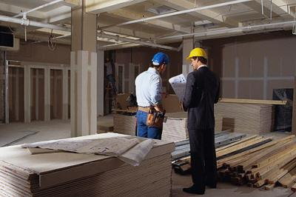
Negotiate the Cost of Improvements
Determine who is responsible for paying Tenant Improvements
Discuss with the landlord what improvements might need to be made in the future and who will be responsible for paying them

Slide 7
Negotiating Use of Space & Additional Costs
Landscaping maintenance
Driveway, sidewalk, parking lot repairs and maintenance
Utilities (electricity, gas, sewer, water)
Insurance on the property (pro-rated among the tenants)
Structural and roof repairs and replacements
Non-structural repairs and maintenance
Mechanical system repairs, maintenance, and replacements

Slide 8
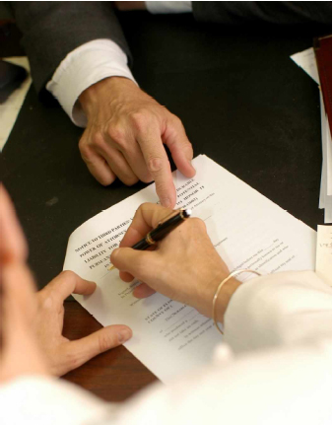
Use an Attorney to Cover Legal Ease

Slide 9
Contact Us
A VESTED INTEREST IN YOUR REAL ESTATE SUCCESS.
Randolph T. Mason
CCIM, SIOR
Commercial Realty Specialists
Direct: 949.751.3151
1501 Quail St., Suite 150
Newport Beach, CA 92660

